Slide 1
Android TIF Introduction
By Chen Changhong

Slide 2
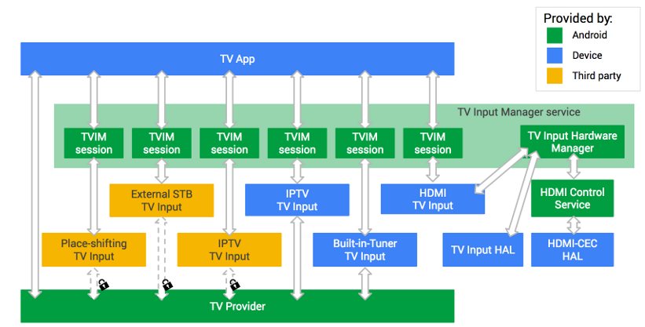
TV Input Framework Architecture
https://source.android.com/devices/tv/

Slide 3
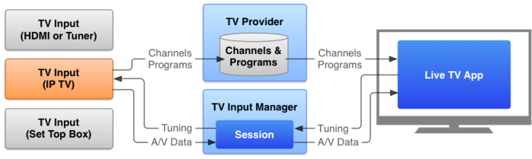
Flow

Slide 4
TV App
TvApp
TvView
mSurface
TvInputManagerHelper
TvInputManager
TvInputManagerService
IPC
TvInputCallback
TV Provider
TvContract
mSession

Slide 5
TV App
/packages/apps/TV/src/com/android/tv/TvActivity.java
/packages/apps/TV/src/com/android/tv/MainActivity.java
一个和用户交互的系统应用
Applications talk to the TV input manager to list TV inputs and check their status.
Once an application find the input to use, it uses TvView or TvRecordingClient for further interaction such as watching and recording

Slide 6
TV App
Setup and configuration
Auto-detect TV Inputs
Let TV Inputs initiate channel setup
Control parental settings
Edit channels
Viewing
Access and navigate all TV channels
Access TV program information bar
EPG
Support multiple audio and subtitle tracks

Slide 7
TV App
void onCreate()
mTvView = (TunableTvView) findViewById(R.id.main_tunable_tv_view)
mTvView.initialize(…)
mTvInputManagerHelper = tvApplication.getTvInputManagerHelper()
void startTV()
TunableTvView.java
mTvView.start(mTvInputManagerHelper);

Slide 8
TvView
/frameworks/base/media/java/android/media/tv/TvView.java
Displays TV contents.
Provides a high level interface for applications to show TV programs from various TV sources that implement TvInputService
surface用于显示视频播放的内容
session可以控制音量的大小等
Dispatch key event, touch event etc. to Session

Slide 9
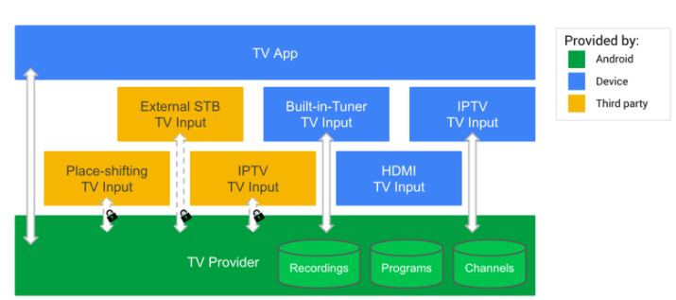
TV Provider
/packages/providers/TvProvider/src/com/android/providers/tv/TvProvider.java
The TV Provider database stores the channels and programs from TV Inputs
Passthrough TV inputs do not store channels and programs.

Slide 10
TvContract
/frameworks/base/media/java/android/media/tv/TvContract.java
The contract between the TV provider and applications. Contains definitions for the supported URIs and columns
TvContract.Channels 频道列表
TvContract.Programs 频道里面的节目单

Slide 11
TvInputManagerHelper
Implement TvInputCallback to get TvInput event
TvInputCallback mInternalCallback = new TvInputCallback(){…}
onInputXXX(){
for (callback : mCallbacks)
callback.onInputStateChanged(inputId, state)
}
mCallbacks
addCallback/removeCallback
Get TvInputManager and register Callback
mTvInputManager = (TvInputManager) context.getSystemService(Context.TV_INPUT_SERVICE)
mTvInputManager.registerCallback(mInternalCallback, mHandler)

Slide 12
TVInputManager
/frameworks/base/media/java/android/media/tv/TvInputManager.java
Central system API to the overall Framework, which arbitrates interaction between applications and the selected TV inputs.
获取TvInputManager
TvInputManager tvInputManager =(TvInputManager) getSystemService(Context.TV_INPUT_SERVICE)

Slide 13
TvInputCallback
/frameworks/base/media/java/android/media/tv/TvInputManager.java
Callback used to monitor status of the TV inputs
onInputStateChanged()
onInputAdded()
onInputRemoved()
onInputUpdated()
onTvInputInfoUpdated()
Usage
/packages/apps/TV/src/com/android/tv/MainActivity.java
mTvInputManagerHelper.addCallback(mTvInputCallback);

Slide 14
TvInputManager
获取Input list
List<TvInputInfo> list = tvInputManager.getTvInputList(); for(TvInputInfo info:list)
{
Log.i(TAG, "id:" + info.getId());
}
Result
id:com.mediatek.tvinput/.component.ComponentInputService/HW1 id:com.mediatek.tvinput/.dtv.TunerInputService/HW0 id:com.mediatek.tvinput/.composite.CompositeInputService/HW2 id:lenovo.com.ismartvlive/.Ismartvliveservice

Slide 15
TvInputManager
void tune(Uri channelUri, Bundle params)
Called by TvView.tune()
Called by TvViewSession.tune()
Called by MainActivity.tune()
Call mService.tune() //ITvInputManager mService
ITVInputManager Service register
SystemServiceRegistry.java
IBinder iBinder = ServiceManager.getServiceOrThrow(Context.TV_INPUT_SERVICE);
ITvInputManager service = ITvInputManager.Stub.asInterface(iBinder);
return new TvInputManager(service, UserHandle.myUserId());

Slide 16
TvInputManagerService
TvInputManagerService
TvInputHardwareManager
TvInputService
TvInputService
HardwareListener

Slide 17
TvInputManagerService
/frameworks/base/services/core/java/com/android/server/tv/TvInputManagerService.java
provides a system service that manages television inputs
mTvInputHardwareManager = new TvInputHardwareManager(context, new HardwareListener());

Slide 18
TvInputHardwareManager
/frameworks/base/services/core/java/com/android/server/tv/TvInputHardwareManager.java
helper class for TvInputManagerService to handle TV input hardware
basic connection management and forwarding calls to TvInputHal which eventually calls to tv_input HAL module.
TvInputHal mHal = new TvInputHal(this);
IHdmiHotplugEventListener mHdmiHotplugEventListener =
new HdmiHotplugEventListener()
onDeviceAvailable()
onDeviceUnavailable()

Slide 19
TvInputService
TvInputService
TvInputService.Session
Passthrough Input
Tuner Input
3rd Party Input

Slide 20
TvInputService
/frameworks/base/media/java/android/media/tv/TvInputService.java
实现onCreatSession()方法返回一个TvInputService.Session对象
例子实现
定义/developers/build/prebuilts/androidtv/sample-inputs/app/src/main/AndroidManifest.xml
实现/developers/build/prebuilts/androidtv/sample-inputs/app/src/main/java/com/example/android/sampletvinput/rich/RichTvInputService.java

Slide 21
TvInputService.Session
TvView通过Tune方法来播放指定的节目,
调用Session的onTune(Uri channelUri)方法来播放uri中的节目
onSetSurface()方法来设置播放的surface

Slide 22
TV Input
TV Input
可以看做是一个代表物理或者虚拟的电视接收器或者输入端口的应用。Input在TIF中可以看做是一个输入源
Implement TvInputService
an input source of TV, which can be a pass-through input such as HDMI, or a tuner input which provides broadcast TV programs.
The system binds to the TV input per application’s request. on implementing TV inputs.

Slide 23
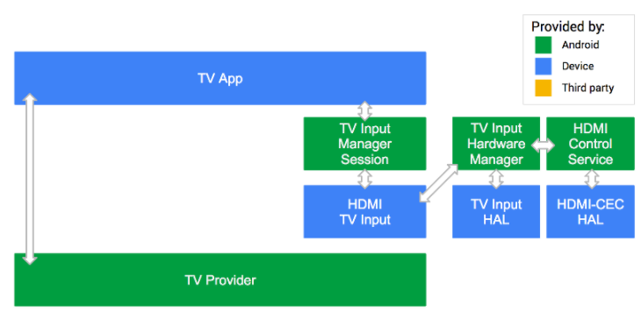
Passthrough input
Some inputs, like the HDMI input can be provided only by the manufacturer as they speak directly with the underlying hardware.
Notes:
To obtain the URI used to reference the passthrough input, use the android.media.tv.TvContract utility method buildChannelUriForPassthroughInput(String inputId). The TV App communicates with the TV Input Manager to reach the HDMI TV Input.

Slide 24
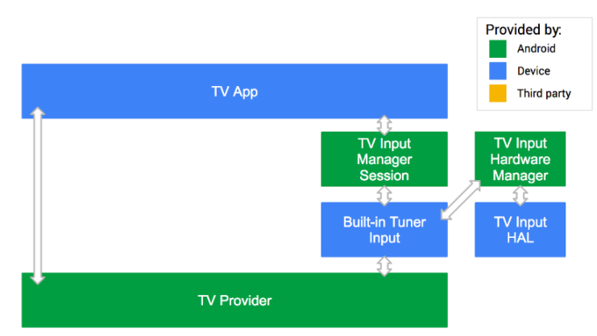
Built-in tuner
In this example, the Built-in Tuner TV Input provided by the device manufacturer is trusted and has full access to the TV Provider.

Slide 25
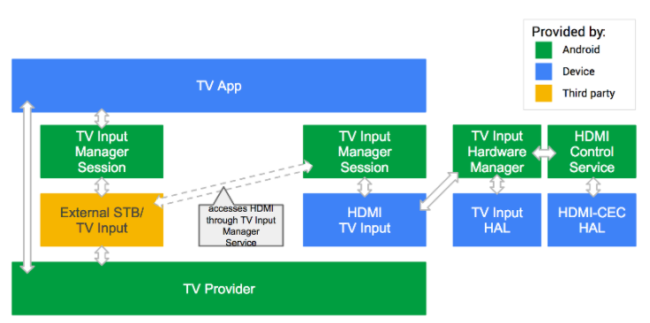
Third-party input
the external STB TV Input is provided by a third party. Since that TV Input can’t directly access the HDMI video feed coming in, it must go through the TV Input Manager and use the HDMI TV Input provided by the device manufacture.
Notes:
Through the TV Input Manager, the external STB TV Input can speak with the HDMI TV Input and ask it to show the video on HDMI1. So the STB TV Input can control the TV while the manufacturer-provided HDMI TV Input renders the video.

Slide 26
TvInput
TvInputInfo
TvInputHal.java
TvInputHal(Native)
TV Input HAL Module

Slide 27
TvInputInfo
/frameworks/base/media/java/android/media/tv/TvInputInfo.java
specify meta information of a TV input
Type(Tuner/Composite/Svideo/HDMI/….)
Label
Icon

Slide 28
TvInputHal(Java)
/frameworks/base/services/core/java/com/android/server/tv/TvInputHal.java
Provides access to the low-level TV input hardware abstraction layer
Call Native Function
nativeOpen
nativeAddOrUpdateStream
nativeRemoveStream
nativeGetStreamConfigs
nativeClose
Called by Native function
onDeviceAvailabledevice ()
onDeviceUnavailable
onStreamConfigurationChanged
onFirstFrameCaptured

Slide 29
TvInputHal(Native)
/frameworks/base/services/core/jni/com_android_server_tv_TvInputHal.cpp
register_android_server_tv_TvInputHal()
Class JTvInputHal
nativeOpen
JTvInputHal::createInstance()
sp<ITvInput> tvInput = ITvInput::getService()
return new JTvInputHal(env, thiz, tvInput, looper))
nativeAddOrUpdateStream
tvInputHanl->addOrUpdteStream(deviceId, streamId, surface)
mTvInput->getStreamConfigurations()
mTvInput->openStream(deviceId, streamId)

Slide 30
TV Input HAL Module
TV Input HAL
tv_input module
TV Input的硬件抽象层，可以让系统的TV inputs访问TV特有硬件

Slide 31
TV Input Skeleton
/hardware/interfaces/tv/input/1.0/default/TvInput.cpp
/hardware/interfaces/tv/input/1.0/default/TvInput.h
struct TvInput : public ITvInput
{
}

Slide 32
TV HAL module skeleton
/hardware/libhardware/modules/tv_input/tv_input.cpp
/hardware/libhardware/include/hardware/tv_input.h
tv_input_module_t
.methods = &tv_input_module_methods
tv_input_module_methods =
// return hw_device_t of tv_input_private_t
.open = tv_input_device_open
tv_input_private_t
tv_input_device_t device
struct hw_device_t common
int (*initialize)(..)
int (*get_stream_configurations)(…)
int (*open_stream)(…)
const tv_input_callback_ops_t* callback

Slide 33
Another Example
https://github.com/songwenju/TIFSample

